Slide 1



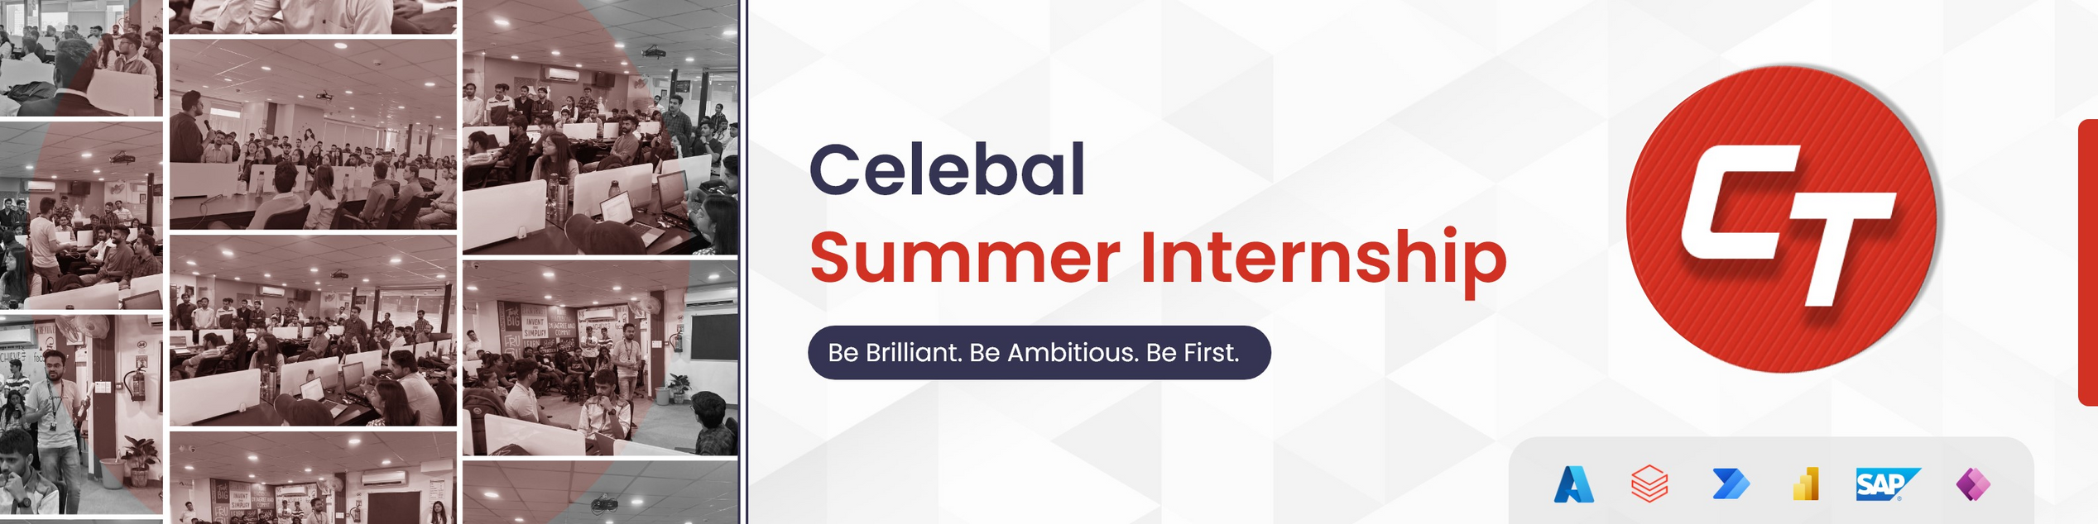
DATA SCIENCE
DEPARTMENT
PRESENTED BY
Dipanshu,
KIIT UNIVERSITY
CSI ID: CT-CSI23/DS0327

Slide 2


CONTENTS
Internship in Celebal technologies in Data Science
Introduction
Machine Learning for Loan Prediction
Features Present in Loan Prediction
Deployment using Streamlit
Conclusion

Slide 3
Internship in Celebal technologies in Data Science
The internship at Celebal Technologies provided me with a solid foundation in data science principles, empowering me to tackle complex data-driven challenges and leverage Machine Learning to extract valuable insights from data.

Slide 4


Loan-Prediction
Understanding the problem statement is the first and foremost step. This would help you give an intuition of what you will face ahead of time. Let us see the problem statement.
Dream Housing Finance company deals in all home loans. They have presence across all urban, semi urban and rural areas. Customer first apply for home loan after that company validates the customer eligibility for loan. Company wants to automate the loan eligibility process (real time) based on customer detail provided while filling online application form. These details are Gender, Marital Status, Education, Number of Dependents, Income, Loan Amount, Credit History and others. To automate this process, they have given a problem to identify the customers segments, those are eligible for loan amount so that they can specifically target these customers.

Slide 5

It is a classification problem where we have to predict whether a loan would be approved or not. In a classification problem, we have to predict discrete values based on a given set of independent variable(s). Classification can be of two types:
Binary Classification : In this classification we have to predict either of the two given classes. For example: classifying the gender as male or female, predicting the result as win or loss, etc. Multiclass Classification : Here we have to classify the data into three or more classes. For example: classifying a movie's genre as comedy, action or romantic, classify fruits as oranges, apples, or pears, etc.
Loan prediction is a very common real-life problem that each retail bank faces atleast once in its lifetime. If done correctly, it can save a lot of man hours at the end of a retail bank.

Slide 6

Loan Approval Prediction
Using the model we have to predict whether a loan would be approved or not.
Steps involved in machine learning
1 - Data Collection
2 - Data Preparation
3 - Choose a Model
4 - Train the Model
5 - Evaluate the Model
6 - Parameter Tuning
7 - Make Predictions

Slide 7
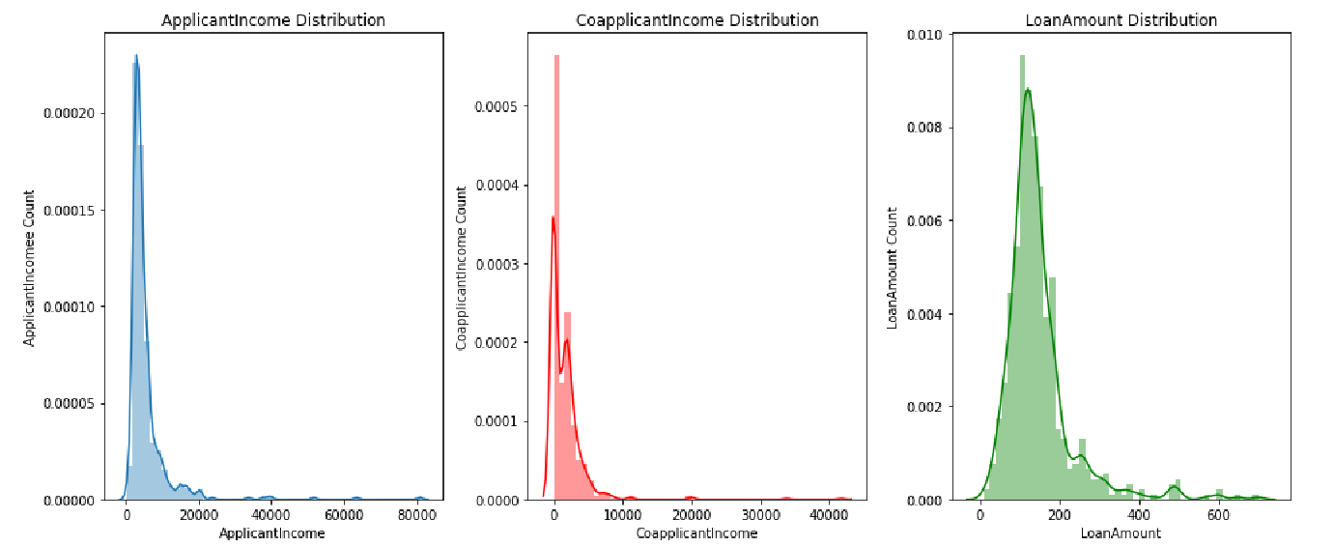
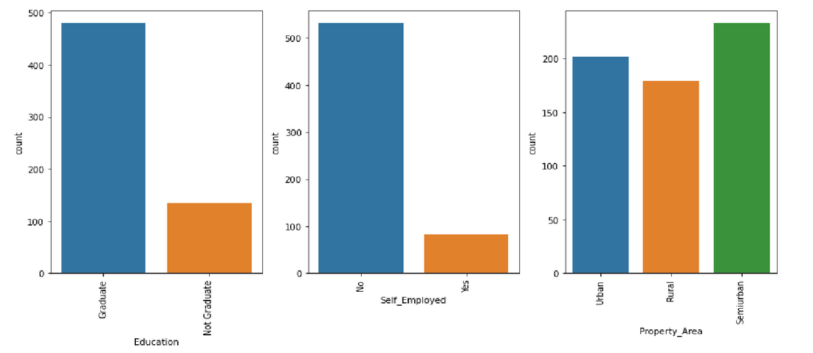
FEATURES PRESENT IN LOAN PREDICTION
Loan_ID – The ID number generated by the bank which is giving loan.
Gender – Whether the person taking loan is male or female.
Married – Whether the person is married or unmarried.
Dependents – Family members who stay with the person.
Education – Educational qualification of the person taking loan.
Self_Employed – Whether the person is self-employed or not.
ApplicantIncome – The basic salary or income of the applicant per month.
CoapplicantIncome – The basic income or family members.
LoanAmount – The amount of loan for which loan is applied.
Loan_Amount_Term – How much time does the loan applicant take to pay the loan.
Credit_History – Whether the loan applicant has taken loan previously from same bank.

Slide 8
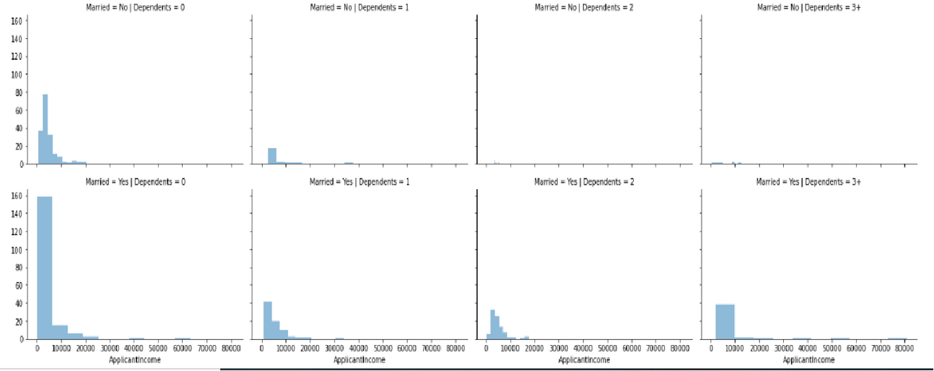
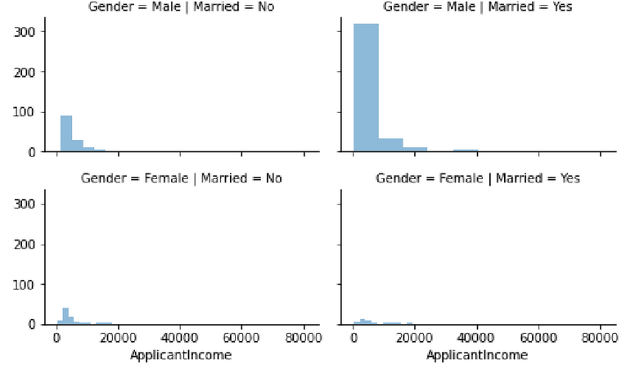
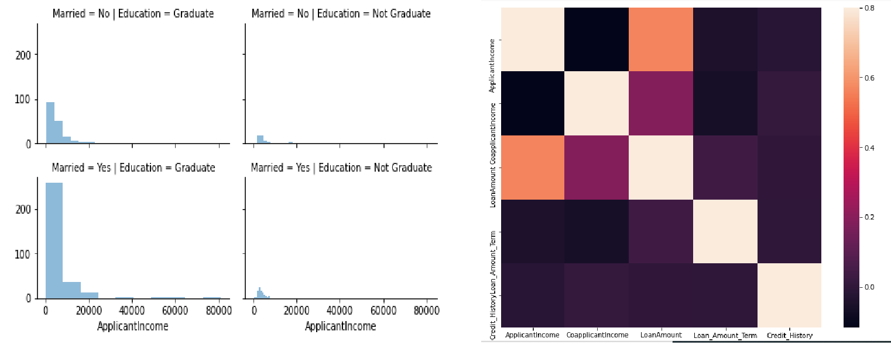
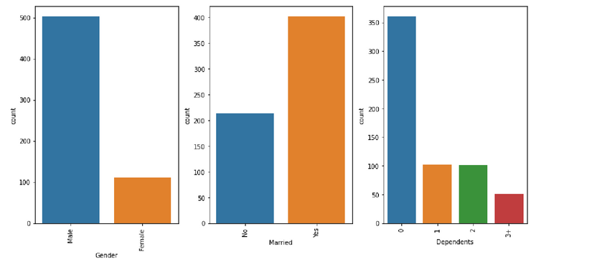
EDA

Slide 9
Model Deployment
Model Development Highlights:
Utilized classification algorithms for prediction.
Data preprocessing, handling missing values, categorical features, and scaling.
Exploratory Data Analysis (EDA) and feature engineering.
Model Evaluation Metrics:
Accuracy, Precision, Recall, F1 Score.

Slide 10
Model Deployment with Streamlit
Streamlit:
Streamlit is an open-source Python library for creating web applications.Designed for easy and quick deployment of data science models.
Steps for Deployment:
a. Create a Pickle file for the trained model.
b. Build a Streamlit web application:
Import necessary libraries (Streamlit, Pandas, NumPy).
Load the trained model from the Pickle file.
Design the user interface (UI) with input fields (age, income, employment status, etc.).
Define a function to take user inputs, preprocess data, and make predictions using the model.
Display the prediction results.
c. Run the Streamlit app locally.
User Interaction:
Users can enter their details in the app.
The model predicts the likelihood of loan approval.
Benefits of Streamlit Deployment:
User-friendly interface.
Easy to share and access.
Real-time predictions.

Slide 11
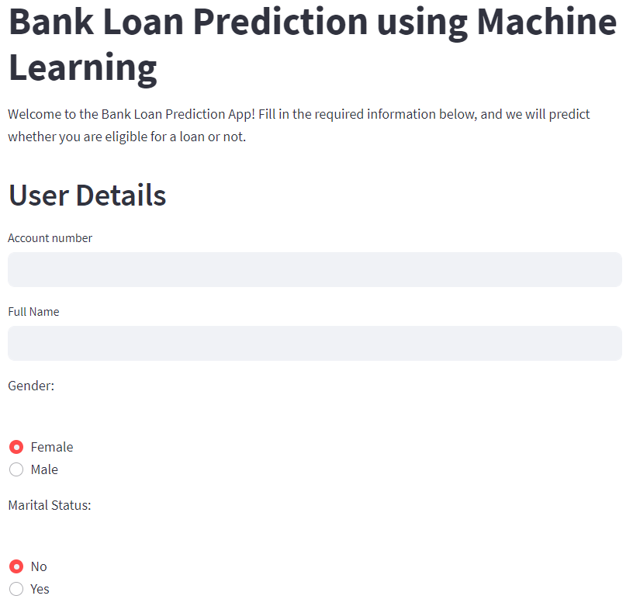
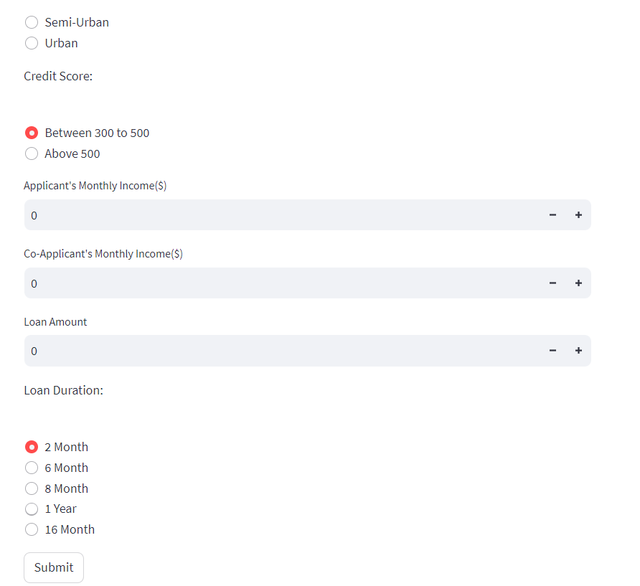

Slide 12
CONCLUSION
In conclusion, this project has allowed us to gain valuable insights into loan approval prediction and apply machine learning techniques to solve a real-world problem. The model's successful deployment using Streamlit ensures its accessibility and usability. We believe our work has the potential to make a positive impact in the financial industry and will continue to explore ways to enhance its performance in the future.
Future Directions:
Further improvements can be made by exploring more advanced algorithms and fine-tuning hyperparameters.
Gathering more diverse data and continuously updating the model will enhance its accuracy and robustness.
Special thanks to our mentors for their guidance and support throughout the journey.

Slide 13
THANK YOU

